Slide 1
Chapter 4
In-depth study of Middleware Architectures
E.g. COM/DCOM, CORBA, .NET

Slide 2
Outline
What is Middleware
Usage/Advantages
Architectural Significance
Middleware Types
Advantages and Disadvantages of Middleware

Slide 3
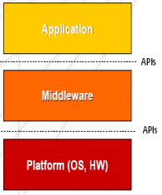
Middleware - Definition
Middleware is connectivity software that consists of a set of enabling services that allow multiple processes running on one or more machines to interact with each other.
Middleware is the "glue" that connects diverse computer systems. Typically, legacy systems store information in proprietary formats, use proprietary protocols to communicate, and may even be running on hardware that's no longer manufactured or supported.

Slide 4
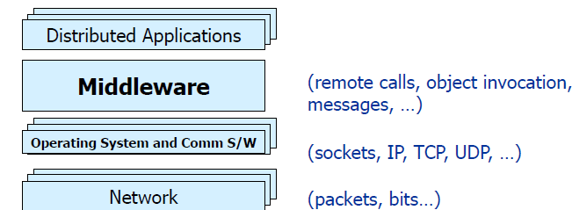
Middleware
What is Middleware?
Layer between OS and distributed applications
Hides complexity and heterogeneity of distributed system
Bridges gap between low-level OS communications and programming language abstractions
Provides common programming abstraction and infrastructure for distributed applications

Slide 5
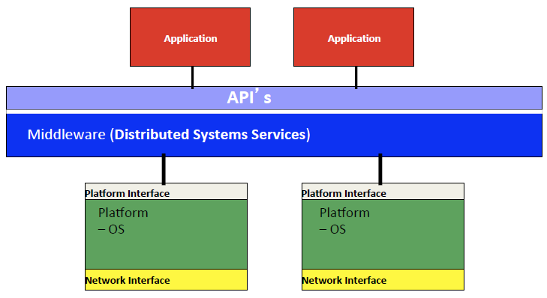
Middleware Architecture

Slide 6
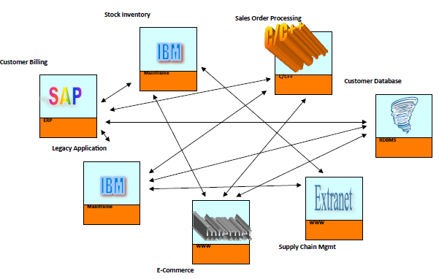
Legacy enterprise situation

Slide 7
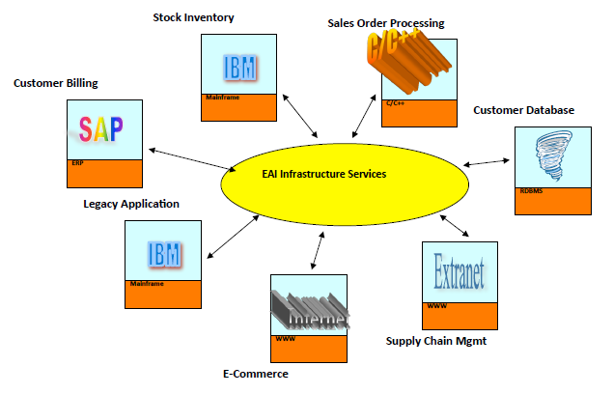
Middleware solution

Slide 8
Middleware - Usage
Middleware services provide a more functional set of API than OS and network services to allow an application to:
Locate transparently across the network, providing interaction with other application or service
Be independent from network services.
Be reliable and available.
Scale-up in capacity without losing functionality.
Real time information access among systems
Streamlines business processes and helps raise organizational efficiency.
Maintains information integrity across multiple systems .

Slide 9
Disadvantages of Middleware
Prohibitively high development costs.
EAI( Enterprise Application Integration) implementations are very time consuming, and need a lot of resources.
There are few people with experience in the market place.
There exists relatively few satisfying standards.
The tools are not good enough.
Too many platforms to be covered.
Middleware often threatens the real-time performance of a system.
Middleware products are not very mature.

Slide 10
Middleware Evolutions
Transaction Processing (TP) monitors
Remote Procedure Calls (RPC)
Message Oriented Middleware (MOM)
Object Request Brokers (ORBs)
Service oriented Architecture(SOA)

Slide 11
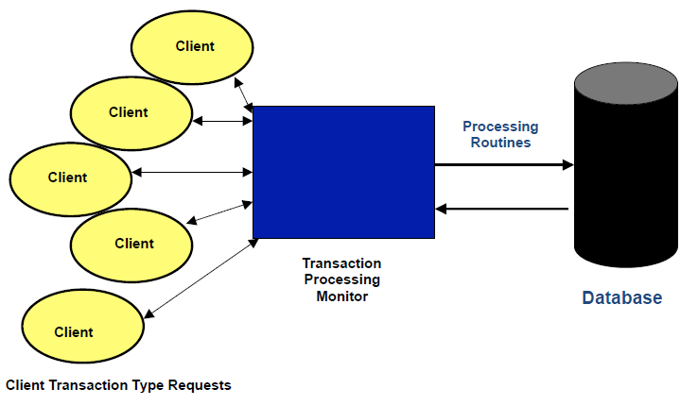
TP Monitors - Demonstration

Slide 12
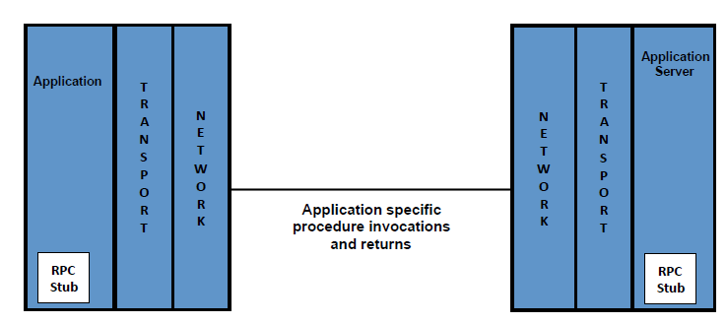
Remote Procedure Call (RPC)

Slide 13
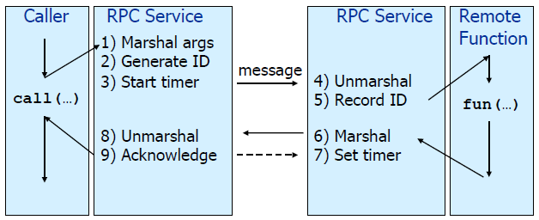
Remote Procedure Call (RPC)
Masks remote function calls as being local
Client/server model
Request/reply paradigm usually implemented with message passing in RPC service
Marshalling of function parameters and return value

Slide 14
Properties of RPC
Language-level pattern of function call
easy to understand for programmer
Synchronous request/reply interaction
natural from a programming language point-of-view
matches replies to requests
built in synchronization of requests and replies
Distribution transparency (in the no-failure case)
hides the complexity of a distributed system
Various reliability guarantees
deals with some distributed systems aspects of failure

Slide 15
Disadvantages of RPC
Synchronous request/reply interaction
tight coupling between client and server
client may block for a long time if server loaded
Leads to multi-threaded programming at client
slow/failed clients may delay servers when replying
multi-threading essential at servers
Distribution Transparency problem
Not possible to mask all problems
RPC paradigm is not object-oriented
invoke functions on servers as opposed to methods on objects

Slide 16
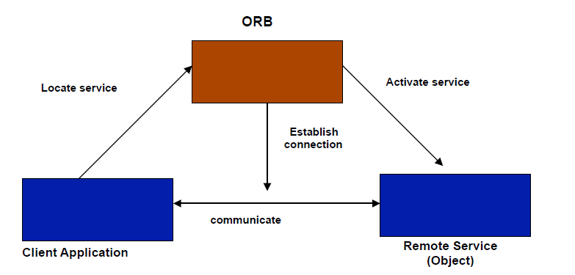
Object Request Broker(ORB)

Slide 17
Object Request Broker (ORB)
ORB is a middleware application component that uses the common object request broker architecture (CORBA) specification, enabling developers to make application calls within a computer network.
ORB is an agent that transmits client/server operation invocations in a distributed environment and ensures transparent object communication.
Major functionality includes:
Interface definition
Location and activation of remote objects
Communication between clients and objects

Slide 18
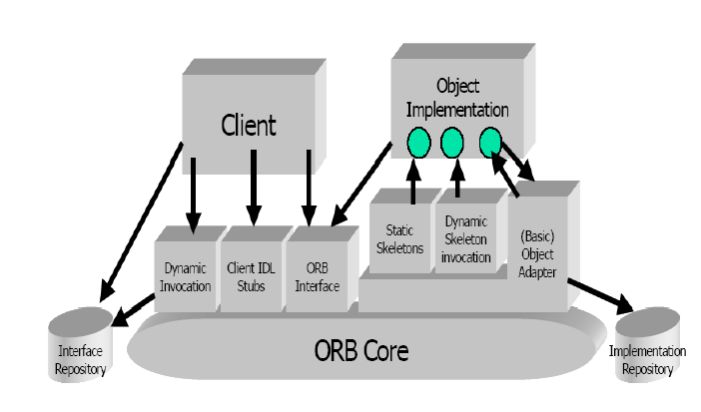
CORBA architecture

Slide 19
CORBA
Common Object Request Broker Architecture
Open standard by the OMG (Object Management Group)
Language and platform independent
Object Request Broker (ORB)
General Inter-ORB Protocol (GIOP) for communication
Interoperable Object References (IOR) contain object location
CORBA Interface Definition Language (IDL)
Stubs (proxies) and skeletons created by IDL compiler
Dynamic remote method invocation
Interface Repository
Querying existing remote interfaces
Implementation Repository
Activating remote objects on demand

Slide 20
CORBA Services (selection)
Naming Service
– Names -> remote object references
Trading Service
– Attributes (properties) -> remote object references
Persistent Object Service
– Implementation of persistent CORBA objects
Transaction Service
– Making object invocation part of transactions
Event Service and Notification Service
– In response to applications‘ need for asynchronous communication
– built above synchronous communication with push or pull options
– not an integrated programming model with general IDL messages

Slide 21
Main CORBA features
Object request broker (ORB)
OMG( Object Management Group) interface definition language(IDL)
Language mapping
Stub and skeletons
Interface repository
Dynamic invocation and dispatch
Object adapters
Inter ORB protocols

Slide 22
Object Oriented Middleware(OOM)
Objects can be local or remote
Object references can be local or remote
Remote objects have visible remote interfaces
Masks remote objects as being local using proxy objects
Remote method invocation

Slide 23
Properties of OOM
Support for object-oriented programming model
objects, methods, interfaces, encapsulation, …
exceptions (were also in some RPC systems e.g. Mayflower)
Synchronous request/reply interaction
same as RPC
Location Transparency
system (ORB) maps object references to locations
Services comprising multiple servers are easier to build with OOM
RPC programming is in terms of server-interface (operation)
RPC system looks up server address in a location service

Slide 24
Disadvantages of OOM
Synchronous request/reply interaction only
So CORBA one way semantics added and -
Asynchronous Method Invocation (AMI)
But implementations may not be loosely coupled
Distributed garbage collection
Releasing memory for unused remote objects
OOM rather static and heavy-weight
Bad for ubiquitous systems and embedded devices

Slide 25
Message Oriented Middleware(MOM)
MOM (Message Oriented Middleware) is a client / server infrastructure which allows the application to be distributed over multiple heterogeneous platforms.
Reduces complexity of applications spanning operating systems and network protocols by insulating them from un-necessary details.
Data is exchanged by message passing and/or message queuing supporting both synchronous and asynchronous interactions between distributed computing processes.
The MOM system ensures message delivery by using reliable queues and by providing the directory, security, and administrative services required to support messaging.

Slide 26
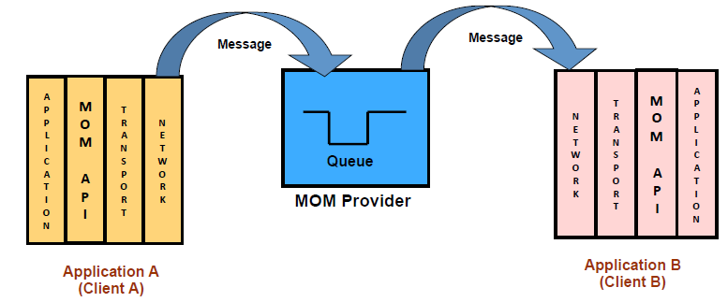
MOM - Demonstration

Slide 27
MOM - Advantages
Asynchronous
Flexible
Portability
Interoperability
Reduces Complexity

Slide 28
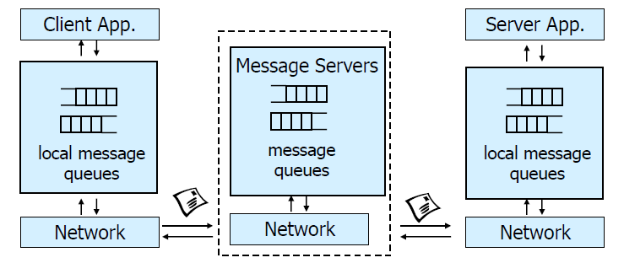
Message-Oriented Middleware (MOM)
Communication using messages
Messages stored in message queues
message servers decouple client and server
Various assumptions about message content

Slide 29
Properties of MOM
Asynchronous interaction
– Client and server are only loosely coupled
– Messages are queued
– Good for application integration
Support for reliable delivery service
– Keep queues in persistent storage
Processing of messages by intermediate message server(s)
– May do filtering, transforming, logging, …
– Networks of message servers
Natural for database integration

Slide 30
Java Message Service (JMS)
API specification to access MOM implementations
Two modes of operation *specified*:
– Point-to-point
• one-to-one communication using queues
– Publish/Subscribe
• Event-Based Middleware
JMS Server implements JMS API
JMS Clients connect to JMS servers
Java objects can be serialized to JMS messages
A JMS interface has been provided for message queue(MQ)
pub/sub (one-to-many) - just a specification?

Slide 31
Web Services
A web service is any piece of software that makes itself available over the internet and uses a standardized XML messaging system. XML is used to encode all communications to a web service
Use well-known web standards for distributed computing
Communication
Message content expressed in XML
Simple Object Access Protocol (SOAP)
– Lightweight protocol for sync/async. communication
Service Description
Web Services Description Language (WSDL)
– Interface description for web services
Service Discovery
Universal Description Discovery and Integration (UDDI)
– Directory with web service description in WSDL

Slide 32
Properties of Web Services
Language-independent and open standard
SOAP offers OOM and MOM-style communication:
Synchronous request/reply like OOM
Asynchronous messaging like MOM
Supports internet transports (http, smtp, ...)
Uses XML Schema for marshalling types to/from programming language types
WSDL says how to use a web service
UDDI helps to find the right web service
• Exports SOAP API for access

Slide 33
Disadvantages of Web Services
Low-level abstraction
• leaves a lot to be implemented
Interaction patterns have to be built
• one-to-one and request-reply provided
• one-to-many?
• still synchronous service invocation, rather than notification
• No nested/grouped invocations, transactions, ...
No location transparency

Slide 34
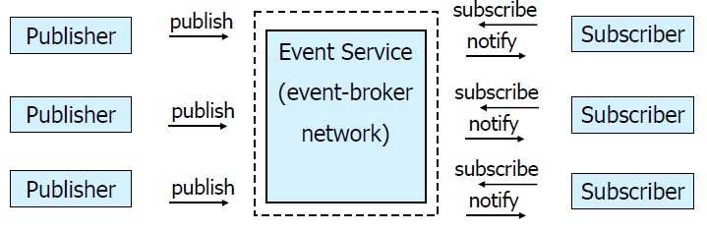
Event-Based Middleware ( Publish/Subscribe)
Publishers (advertise and) publish events (messages)
Subscribers express interest in events with subscriptions
Event Service notifies interested subscribers of published events
Events can have arbitrary content (typed) or name/value pairs

Slide 35
Properties of Publish/Subscribe
Asynchronous communication
• Publishers and subscribers are loosely coupled
Many-to-many interaction between pubs. and subs.
• Scalable scheme for large-scale systems
• Publishers do not need to know subscribers, and vice-versa
• Dynamic join and leave of pubs, subs
(Topic and) Content-based pub/sub very expressive
• Filtered information delivered only to interested parties
• Efficient content-based routing through a broker network

Slide 36
COM/DCOM
Component Object Model (COM)/Distributed Component Object Model(DCOM)
Microsoft’s middleware infrastructure in many ways similar to CORBA
Defines a binary standard for component interoperability
Programming language independence
Platform independent
Windows (95, 98, NT)
Mac
Unix
Distribution transparency
Does exploit operational characteristics
Dynamic component loading and unloading

Slide 37
DCOM
DCOM = COM binary standard
+
runtime infrastructure for communicating across distributed address spaces initially only on Windows
adding Mac and Unix
Attempts to address challenges of distributed computing interacting components should be “close” to one another some components’ locations are fixed inverse relationship between component size and flexibility

Slide 38
.NET – What Is It?
Software platform
Language neutral
In other words:
.NET is not a language (Runtime and a library for writing and executing written programs in any compliant language)
.NET is a new framework for developing web-based and windows-based applications within the Microsoft environment.
The framework offers a fundamental shift in Microsoft strategy: it moves application development from client-centric to server-centric.
Dramatically simplifies development and deployment
Supports multiple programming languages

Slide 39
.NET – What Is It?
.NET Application
.NET Framework
Operating System + Hardware

Slide 40
.NET Framework Services
Common Language Runtime
Windows Forms
ASP.NET
Web Forms
Web Services
ADO.NET, evolution of ADO
Visual Studio.NET
Notes:
Common Language Runtime
Common, secure execution environment.
We’ll drill into this in some detail in the first parts of the presentation.
Windows® forms
Framework for building rich clients
A demonstration will highlight some of these features, such as the delegate-based event model.
ASP.NET
Web forms
Manageable code (non spaghetti)
Logical evolution of ASP (compiled)
Again, we’ll drill into a hint at the power of Web Forms with a demonstration
Web Services
Programming the Internet to leverage the "power at the edge of the cloud".
We will cover this in detail, as this – along with the CLR – is one of the more powerful aspects of .NET Framework.
ADO.NET, evolution of ADO
New objects (e.g., DataSets, Datareader)
Visual Studio.NET
Most productive development environment gets better and fully supports the .NET Framework

Slide 41
Note
Common Language Runtime
Common, secure execution environment.
We’ll drill into this in some detail in the first parts of the presentation.
Windows® forms
Framework for building rich clients
A demonstration will highlight some of these features, such as the delegate-based event model.
ASP.NET
Web forms
Manageable code (non spaghetti)
Logical evolution of ASP (compiled)
Again, we’ll drill into a hint at the power of Web Forms with a demonstration
Web Services
Programming the Internet to leverage the "power at the edge of the cloud".
We will cover this in detail, as this – along with the CLR – is one of the more powerful aspects of .NET Framework.
ADO.NET, evolution of ADO
New objects (e.g., DataSets, Datareader)
Visual Studio.NET
Most productive development environment gets better and fully supports the .NET Framework

Slide 42
Common Language Runtime (CLR)
CLR works like a virtual machine in executing all languages.
All .NET languages must obey the rules and standards imposed by CLR. Examples:
Object declaration, creation and use
Data types, language libraries
Error and exception handling
Interactive Development Environment (IDE)
Development
Mixed language applications
Common Language Specification (CLS)
Common Type System (CTS)
Automatic memory management
Consistent error handling
Deployment
Removal of registration dependency

Slide 43
Contd..
CTS is a rich type system built into the CLR
Implements various types (int, double, etc)
And operations on those types
CLS is a set of specifications that language and library designers need to follow
This will ensure interoperability between languages
CLR sits on top of OS to provide a virtual environment for hosting managed applications
What is CLR similar to in Java?
Java Virtual Machine (JVM)
CLR loads modules containing executable and executes their code
IL(Intermediate Language) instructions are just-in-time (JIT) compiled into native machine code at run time

Slide 44
Compilation in .NET
Code in VB.NET
Code in C#
Code in another
.NET Language
VB.NET compiler
C# compiler
Appropriate
Compiler
IL(Intermediate
Language) code
CLR just-in-time
execution

Slide 45
Intermediate Language (IL)
.NET languages are not compiled to machine code.
They are compiled to an Intermediate Language (IL).
CLR accepts the IL code and recompiles it to machine code.
The recompilation is just-in-time (JIT) meaning it is done as soon as a function or subroutine is called.
The JIT code stays in memory for subsequent calls.
In cases where there is not enough memory it is discarded thus making JIT process interpretive.

Slide 46
Languages
Languages provided by MS
VB, C++, C#, J#, JScript
Third-parties are building
APL, COBOL, Pascal, Eiffel, Haskell, ML, Oberon, Perl, Python, Scheme, Smalltalk…

Slide 47
Windows Forms
Framework for Building Rich Clients
RAD (Rapid Application Development)
Rich set of controls
Data aware
Printing support
UI inheritance

Slide 48
Thank You !

